Slide 1
Express Innovation:
Faculty Professional Development
Webinar 1
Notes:
Overview of Webinar
Introduce Whiteboards: “Keys to Successful Implementation”; “Goals”; “Modalities”; “Parking Lot”; “Professional Development Ideas”
Introduce tab with the PowerPoint

Slide 2
Today
Goals
Engaging Faculty
Models
Creating a Shift (Big Idea and Methods)
Questions
Next Steps
Notes:
Whiteboards
Chat
Materials Available – download from the site now. On Bloomfire this week.
Building on work you’ve done and tools you’ve experienced and used.

Slide 3
Goals

Slide 4
What do I want to accomplish?
Sustain Innovation
Sustain the EI model
Implement Consistent Powerful Learning
Notes:
Note that the goals are a bit different for EI Network Congregations, but that the principles remain the same.

Slide 5
Goals
Sustain Innovation & the EI model
Engage Faculty around understanding and creating the model.
Engage around Priority Goal
Engage around Model
Notes:
Note that the goals are a bit different for EI Network Congregations, but that the principles remain the same.

Slide 6
Engage
Notes:
What’s the right word? Shifting Belief/Value and Ownership?

Slide 7
What do I mean for today…
Creating a Shift in Belief/Value
OR
Deepen Ownership
Notes:
Big IDEA FOR TODAY
What’s the right word? Shifting Belief/Value and Ownership?
Alignment

Slide 8
Notes:
Why is it so important to engage faculty?

Slide 9
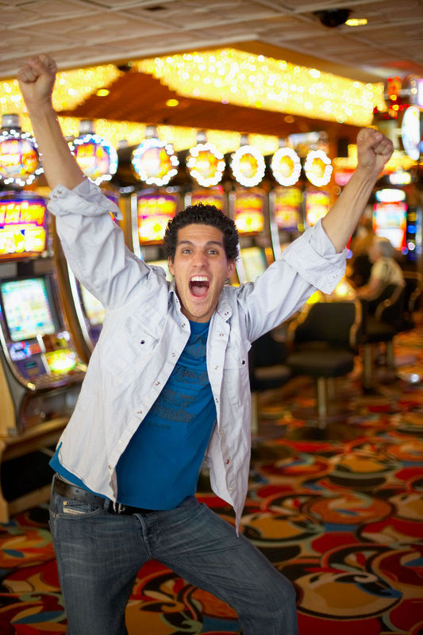
Notes:
Why is it so important to engage faculty?

Slide 10
Why is it so important to engage faculty?
Notes:
Why is it so important to engage faculty? - See Whiteboard

Slide 11
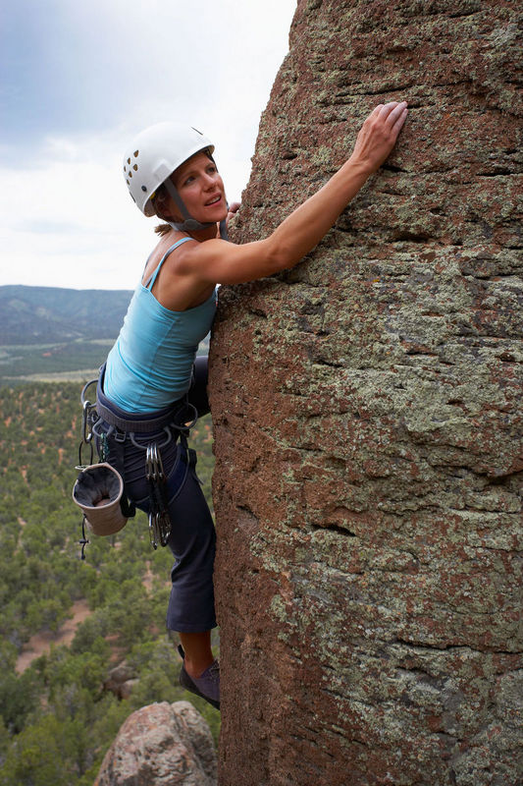
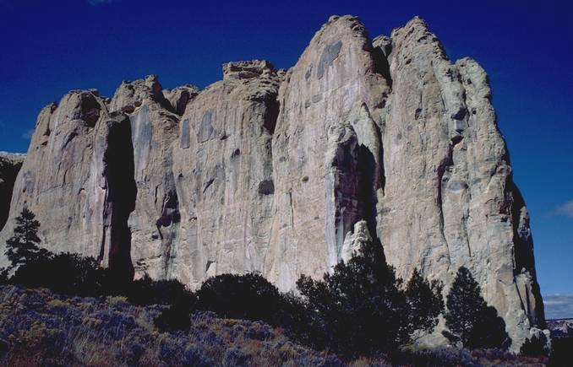
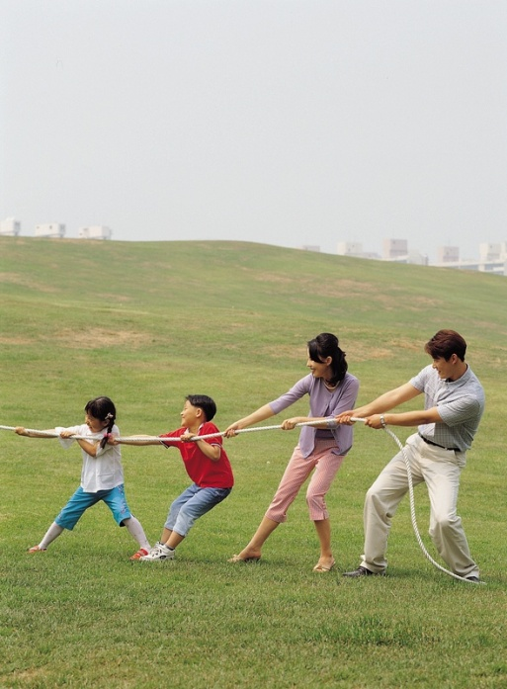
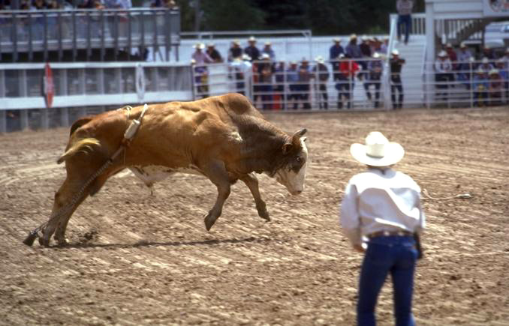
What about engaging faculty is so hard?
Notes:
You may also think about:
New People
Deepening engagement
Why is engaging faculty so hard? – See whiteboard.
Spring Webinar

Slide 12
How to create a Shift in belief/
Deepen ownership?
Notes:
Despite being hard, here are some methods… To set up structure for Professional Development
To Engage within the structure.

Slide 13
Models for Faculty Development
including… Creating a Shift/ Deepening Ownership for Faculty

Slide 14
What are some models/techniques?

Slide 15
Model:
Great when paired with conversations, in-person meetings:
Written Communication – Newsletter each week
Share books and articles
Private Facebook Group
Essential Elements
Regular Faculty Meetings
One on One meetings
Contracted Learning Time
Mentorship
Release Time
Notes:
Keep in mind that modalities are goal dependent…
Create List of Other Modalities on a Whiteboard to Share with Next Webinar and This Group.
Facebook or Other – Sharing articles, etc.
Don’t want to think that 1-3 work on their own, they only come to support more intentional work.

Slide 16
Release Time
Madrichim and Cantor take children for minyan and staff learns together
Clergy and Parents lead learning with kids for 45minutes so staff can gather for learning
School ends ½ hour early so staff can learn together.
Double up classes for ½ hour at a time.

Slide 17
Create A Shift in Belief/Value (KDBB)
Deepen Ownership
Notes:
Deepening instead of Shift?

Slide 18
K – Knowing (knowledge)
D – Doing (Skill)
B/V – Believing/Valuing
(Create a Shift)
B – Belonging
Notes:
Bloom Might say that “Belonging” is an attitude or “belief”, but I believe that it needs to be set apart and attended to each time with our teams.

Slide 20
Methodology
Notes:
Note that all are Booster Related

Slide 21
How might you use professional development to create a shift in Belief/Value in and/or Deepen Ownership of a model?
Notes:
How might you use professional development to create a shift in Belief/Value in, Attitude towards, or Ownership of a model?
All of these can translate to the classroom/learning space as well.

Slide 22
Most Memorable Jewish Learning Experience
Share your most/ a memorable Jewish Learning Experience.
What are the common characteristics?
Therefore we do _______ in our model.
Notes:
Ask for volunteers.
Unpack the Characteristics
THEREFORE TO OUR MODEL….
Curiosity – Questions as windows to great learning

Slide 23
Hopes and Dreams Conversation
What are your hopes and dreams for your students/ learners/ families?
What are the common characteristics?
Therefore we do _______ in our model.
Notes:
Ask for volunteers.
This is the same as what EI did with the first Social Connector Conversation with parents… can work with staff and translates to the classroom with minor tweaks.
THEREFORE TO OUR MODEL….

Slide 24
The Priority Goal, Values, Goals Conversation #1
Three Questions From EI “Reflection Guide”
Where have we been most successful this year with our model?
What do we want to make sure we do more of next year?
In reflecting on our answers to the questions above, what does it appear are our values?
Notes:
Aimed at peers (social connectors) influencing peers around particular ideas, concepts, new models, etc.
An opportunity for people to talk about what’s important to them with a frame and a connection to influencing/learning.
Educators may learn something from the conversation or get feedback along the way, but that’s not the main focus of the conversation (So, if you’re doing the handout at Purim, how does that move from just feedback to having influence on attitudes and social connections).
The possibility of deepening connections between participants.

Slide 25
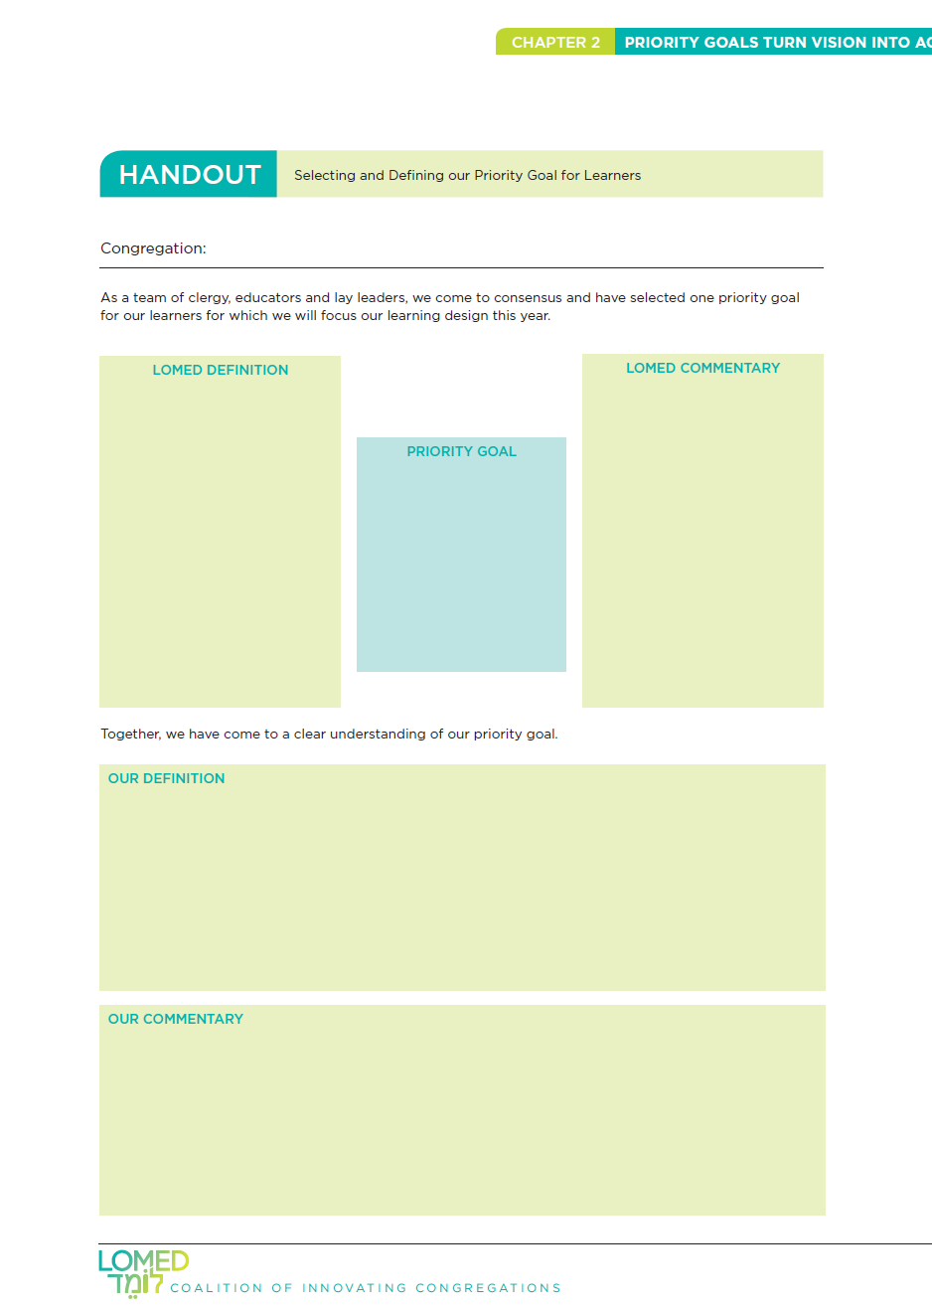
The Priority Goal, Values, Goals Conversation #2
The Talmud Page
Notes:
Can be found in the LOMED Handbook and Information about Priority Goal can be found in the EI Planning Guide (Summer 2013)
Aimed at peers (social connectors) influencing peers around particular ideas, concepts, new models, etc.
An opportunity for people to talk about what’s important to them with a frame and a connection to influencing/learning.
Educators may learn something from the conversation or get feedback along the way, but that’s not the main focus of the conversation (So, if you’re doing the handout at Purim, how does that move from just feedback to having influence on attitudes and social connections).
The possibility of deepening connections between participants.

Slide 27
These Provide an Opportunity to be heard, to hear others, to connect what faculty know to the work they are doing.
Notes:
More important to be heard than to be right.

Slide 28
Planning with a partner

Slide 29
Three Questions to end with each time:
What do you already do that’s consistent with the approach of Shifting Belief /Deepening Ownership?
What needs clarification in order for you to take something with you?
What one new thing might you try?
Notes:
Both about today and about what you can do with faculty.

Slide 30
Questions?

Slide 31
What one thing are you going to implement related to faculty professional development between now and December 8 Living and Learning?
Notes:
Planned, Outlined, Done…

